Slide 1

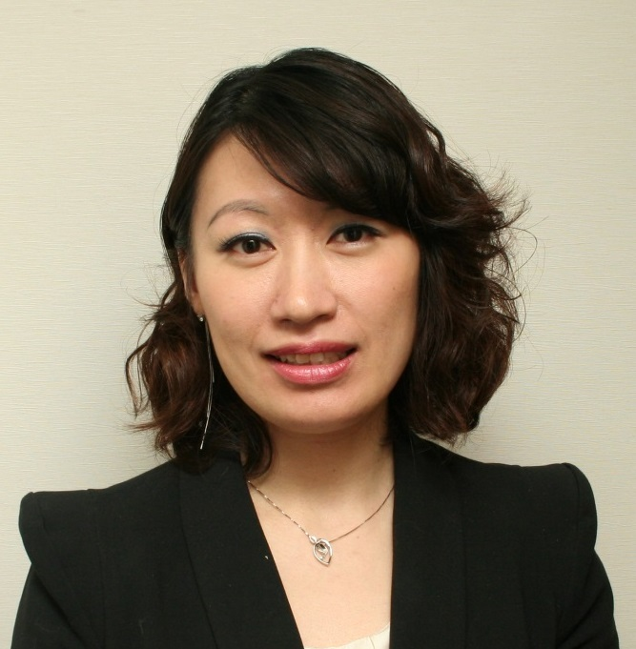

Isotonix®及新產品巡禮
Isotonix® & New Products Spotlight
Emmy Yeung
產品拓展經理
Product Manager
本簡報中提到的收入等級純屬舉例說明，無意代表美安香港超連鎖™店主的一般收入，也無意表示任何超連鎖™店主皆可賺取同等收入。美安香港超連鎖™店主的成功與否，取決於其在發展事業時的努力、才能與投入程度。The income levels mentioned in the following presentation are for illustration purposes only. They are not intended to represent the income of a typical Market Hong Kong UnFranchise ™Owner, nor are they intended to represent that any given Independent UnFranchise ™ Owner will earn income in that amount. The success of any Market Hong Kong Independent UnFranchise ™ Owner will depend upon the amount of hard work, talent, and dedication which he or she devotes to building his or her Market Hong Kong Business.

Slide 2

Health Supplements Purchasing
 | 2008 | 2014 | Difference
Average total spending per 4 weeks per person | $409 | $744 | +82%
Market size per year | 10 Billion | 19 Billion | +90%

Slide 3
Health Supplements Intake
More amongst who reported yes: Income above $20,000

Slide 4
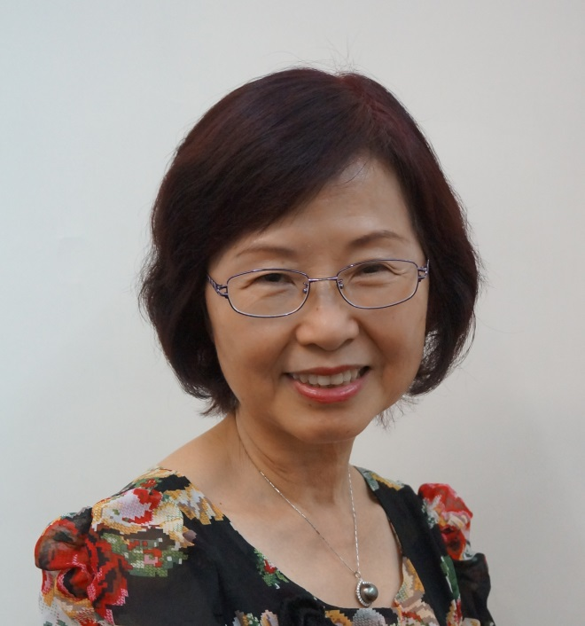
Winnie Wu
A registered nurse in Hong Kong
A registered midwife in Hong Kong
A registered nurse in California, US
Bachelor of Nursing (Monash University, Australia)
Master of Nursing (Monash University, Australia)
A fellow of primary health care
Master UFO Winners
TLS® Certified Coach
此演講的內容並未受美國食品及藥物管理局評核。此產品並非作為診斷、醫療或預防任何疾病或狀況之用途。The statements contained in this presentation have not been evaluated by the Food and Drug Administration. This product is not intended to diagnose, treat, cure or prevent any disease.

Slide 5

2016 Health Facts of Hong Kong
Health Status | Male | Female | Both Sexes
Inadequate physical activity (by WHO’s recommendations) | 56.3% | 68.0% | 62.5%
Inadequate fruit & vegetable intake (<5 servings per day) | 85.9% | 76.6% | 81.0%
Overweight & obesity (BMI ≥23.0) | 49.6% | 29.5% | 39.0%

Slide 6
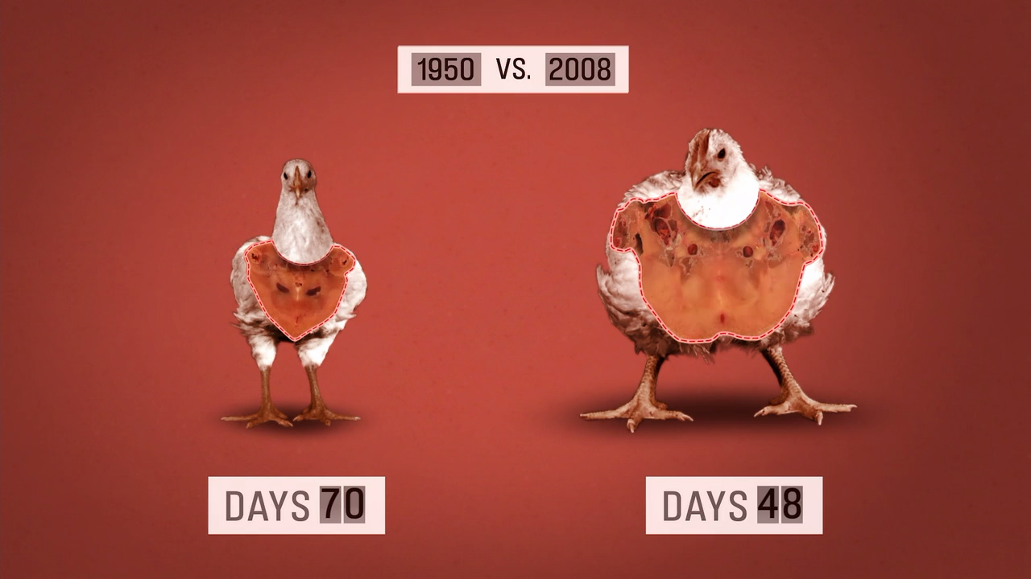
What Puts Food at Risk?
Foods have become significantly depleted in their contents of
antioxidants and supporting minerals.
Factors
Mineral depletion in soil
Mono-culture crops & agriculture
Food transport issues
Highly processed foods
Poor food choices & food preparation

Slide 7
We live longer
Need more calcium
  To sustain our bone health/maintain mobility
Need more DHA
  To keep a fresh mind and reasonable memories
Need more iron/vitamin D
  To enhance our immune system, fight against respiratory infections
Need more antioxidants
  To reduce chance of getting cancer
Life Expectancy
81.2
Male:
86.9
Female:

Slide 8
Isotonix®
Meeting Your Nutritional needs with Controlled Delivery

Slide 9
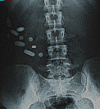

Slide 10
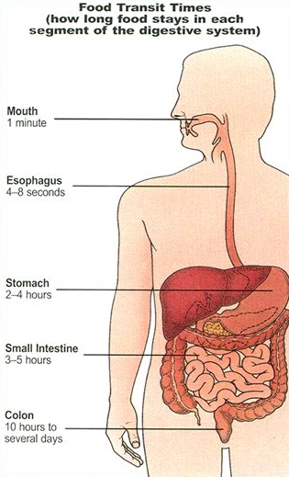
Food Transit Times (how long food stays in each segment of the digestive system?)

Slide 11
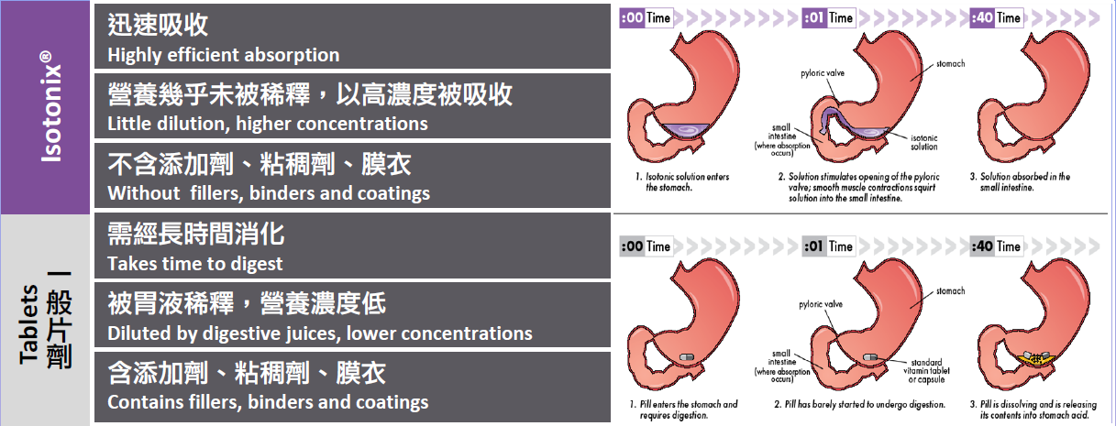
Better Absorption Efficiency

Slide 12
Isotonic
Iso means "the same"
Tonic means "pressure" or "tone”
When used to describe solutions that are meant for consumption, isotonic means having the same fluid pressure as body fluids. Tears, blood plasma, lymph and other body fluids are all isotonic

Slide 13
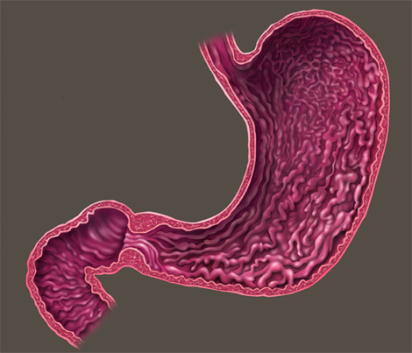
Solutions Poured Directly into
Stomach and Duodenum
Duodenal Sensors

Slide 14
Pathway of Drug Absorption
Intravenous injection
Absorbent
Intramuscular injection
Subcutaneous injection
Oral
Skin absorption

Slide 15
Each Ingredient has Multiple Functions
Ingredient | Primary Function | Secondary Function | Tertiary Function
Fructose | Control Gastric Emptying | Osmolality | Sweetener
Glucose | Control Gastric Emptying | Osmolality | Sweetener
Citric Acid | Buffer | Taste | Effervescence
Malic Acid | Buffer | Taste | Effervescence
Silicon Dioxide | Desiccant | Flow Agent
Maltodextrin | Moisture Control | Osmolality | Mouth Feel
Potassium Bicarbonate | Buffer | Effervescence
Calcium Sulfate | Desiccant | Flow Agent

Slide 16
Isotonix® is formulated for fast, controlled delivery of nutrients.
Isotonix® products actually regulate gastric emptying because they have been carefully formulated using the right ratio of sugars in the right amounts. Because of this, Isotonix products do not limit vitamin absorption by saturating the absorption sites.

Slide 17
How Fast is “Fast”?
M.R. Cesarone, et al. Phytother. Res. 2009
Tablet only partially dissolved when leaving stomach.
Accelerated Antioxidant Bioavailability of OPC-3 Bioflavonoids Administered as Isotonic Solution. Cesarone MR, Grossi MG, Di Renzo A, Errichi S, Schönlau F, Wilmer JL, Lange M, Blumenfeld J. Phytother Res. 2009 Jun;23(6):775-7.
Notes:
So how fast is “fast?”
Here is a study done with OPC-3 in Isotonix form and tablet form. The reduction in free radicals in the blood was monitored over time. The red bars, representing Isotonix OPC-3 took only 7-8 minutes after consumption to achieve maximum activity in the blood. While the same amount of OPC-3 in tablet form slowly built up concentration in the blood over a period of 1 hour. One reason for this is because the tablet, which was formulated to immediately release, was propelled into the intestine before it fully dissolved. This is because the water used to take the pill could not control gastric empyting like an Isotonix solution.

Slide 18
Isotonix® Advantages
Isotonix products clear the stomach at an optimal rate to maximize absorption
Isotonix products are buffered to protect nutrients from hydrochloric acid degradation in the stomach.
Carbon dioxide created by the effervescent reaction momentarily reduces the thickness and viscosity of the mucus layer of the intestinal tract, promoting absorption into the bloodstream
Isotonix offers an alternative to pills

Slide 19
Why are pills used?
Some ingredients are not water soluble or dispersible.
Some ingredients have an odor or taste not easily masked.
Some ingredients are oils or oily.
Plant-based ingredients are made into pills so that they go through the normal digestive process; releasing the actives

Slide 20
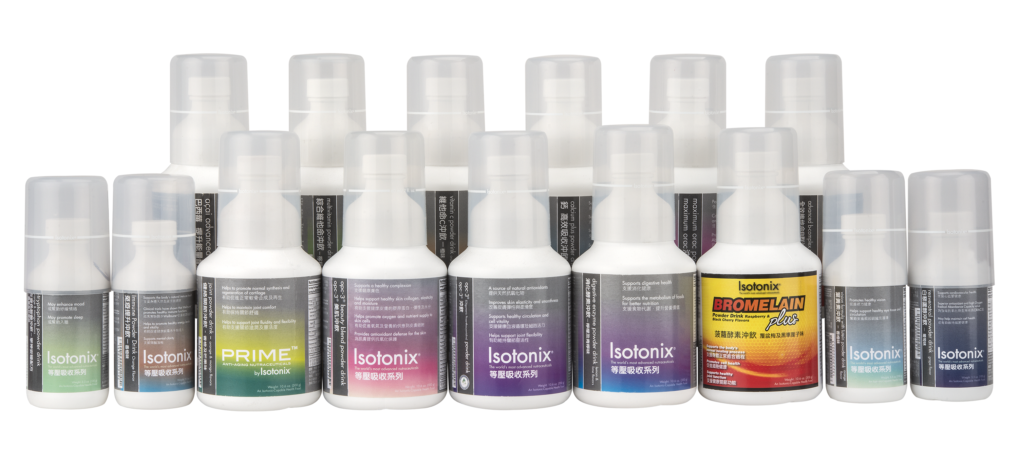
Isotonix® Products

Slide 21
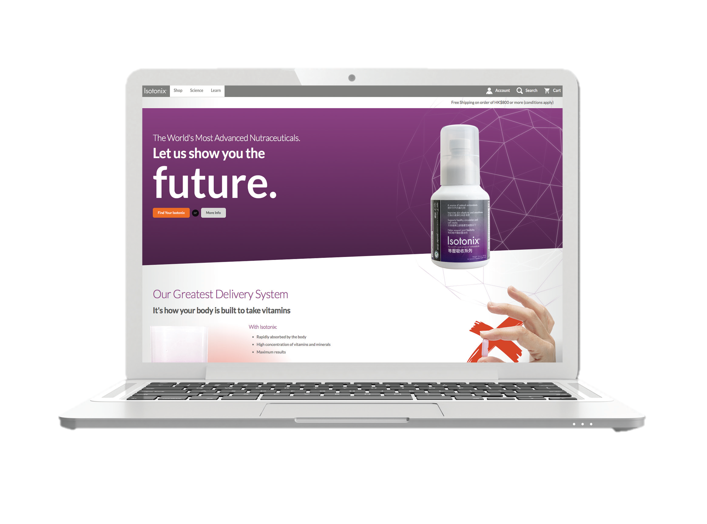
HK.ISOTONIX.COM is now available!
Professional design
Educational videos and Infographics
Benefits of the featured ingredients in products
Detailed product information
Fully responsive, meaning pages can be fully enjoyed on any device

Slide 22
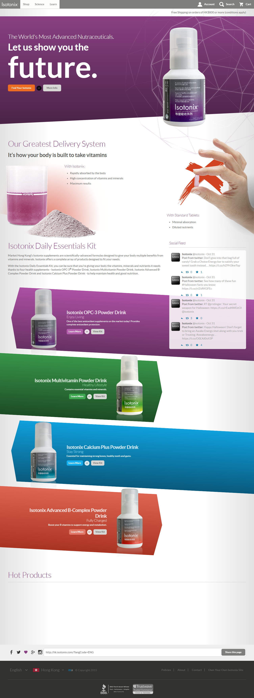

Slide 23
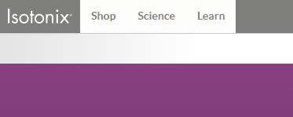
Order directly from hk.isotonix.com!

Slide 24
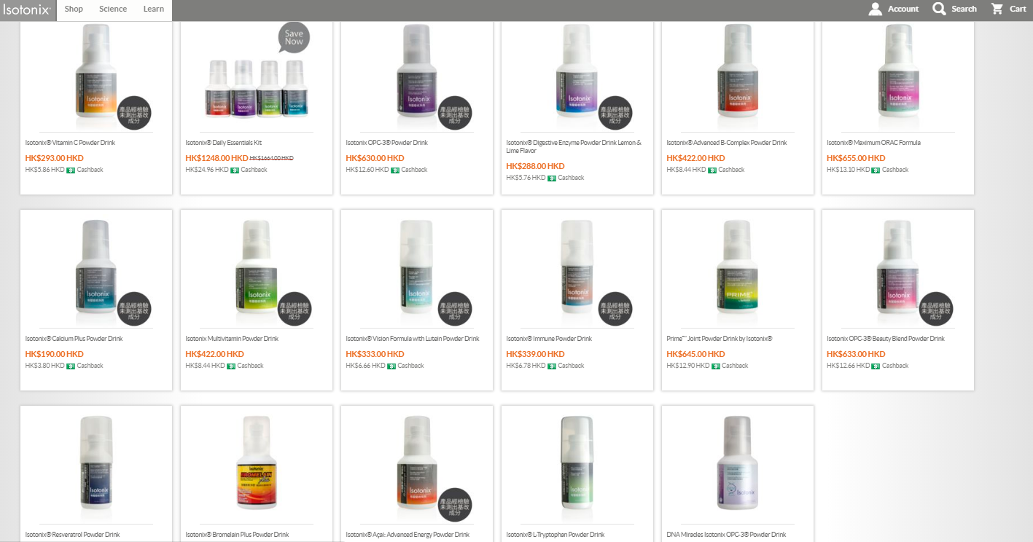

Slide 25
Discover the power o f all Isotonix Products.

Slide 26
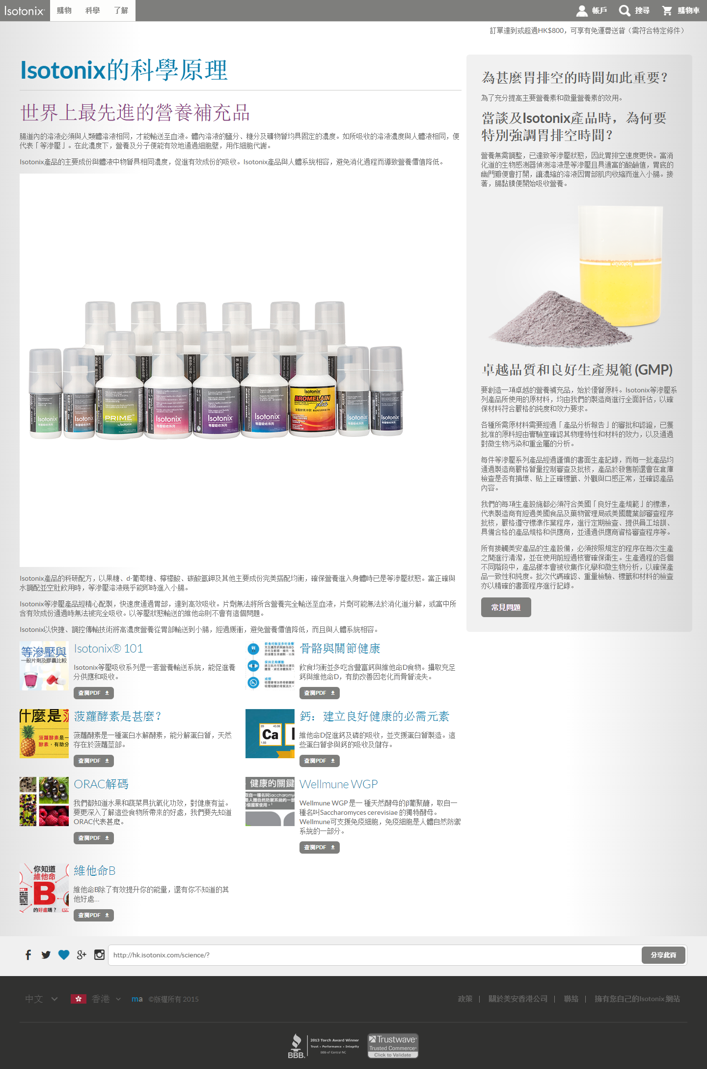

Slide 27
Helping you customers learn more about our products

Slide 28
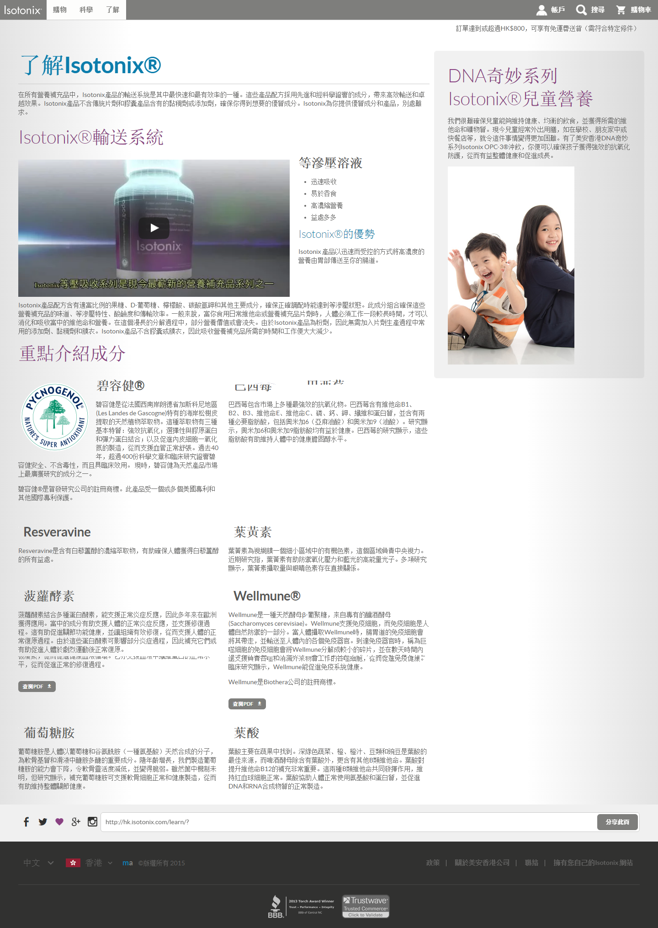

Slide 29


New Products Spotlight

Slide 30
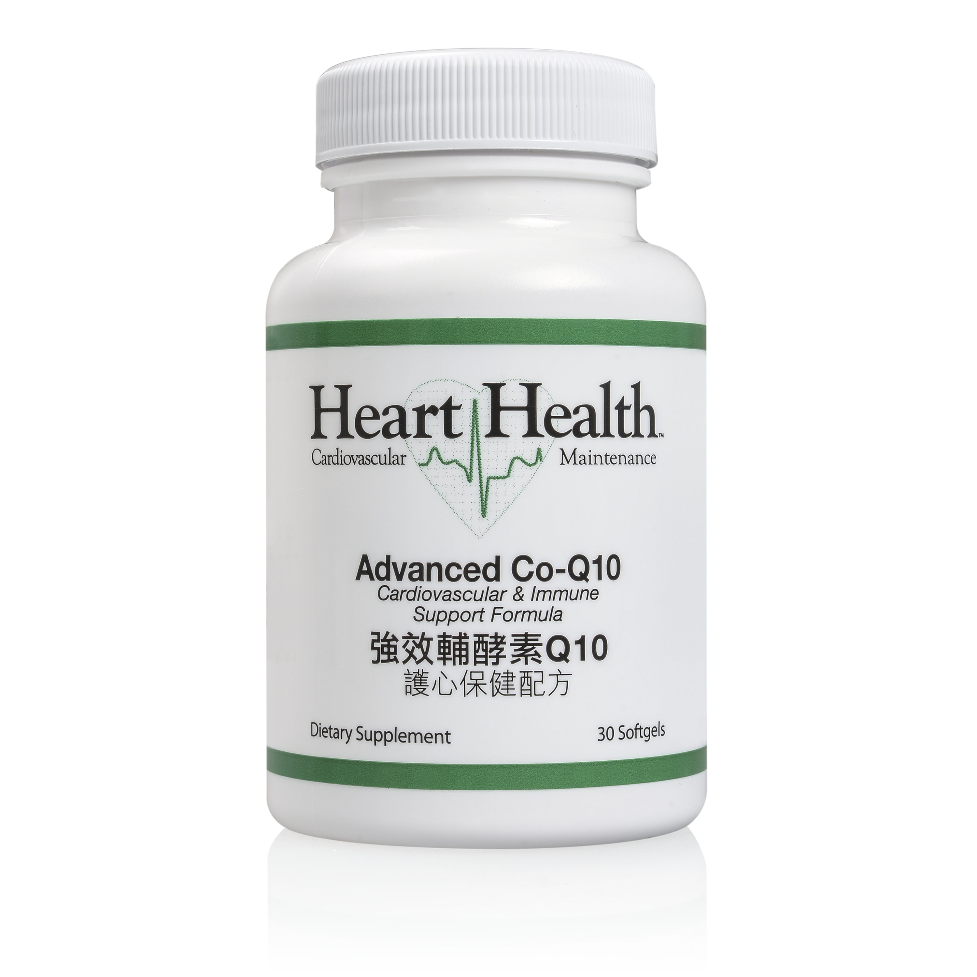
Heart Health™ Advanced Co-Q10

Slide 31
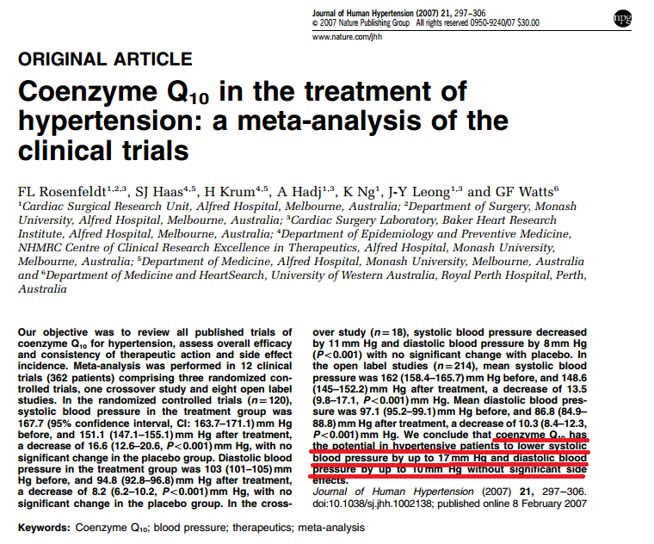
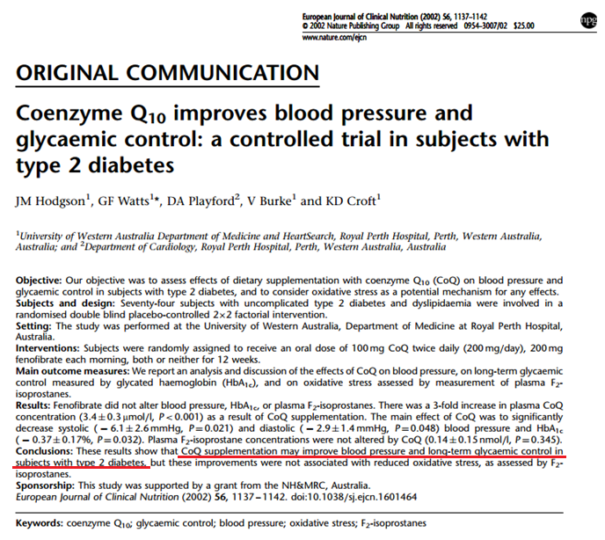
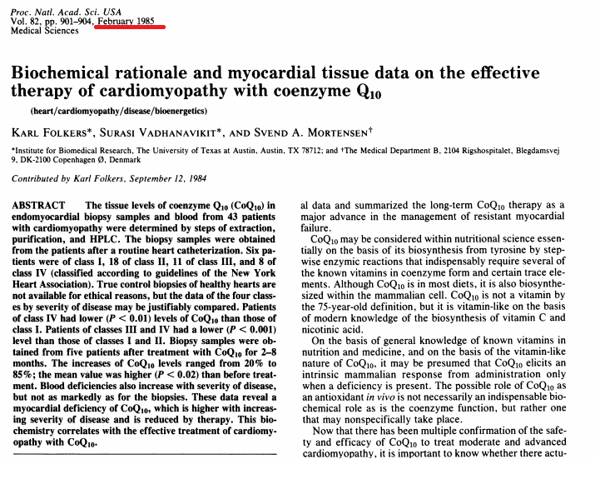

Slide 32
Key Ingredients:
Coenzyme Q10 → CoQsol-CF™
Vitamin E
CoQsol-CF™
Patent-pending formula of CoQ10, food grade d-limonene (which serves as a non-polar, organic solvent), and tocopherol (vitamin E). This combination creates a liquid, crystal-free solution of CoQ10 that provides enhanced bioavailability.

Slide 33
Primary Benefits:
May assist in stabilizing blood sugar*
May assist in stabilizing blood pressure*
Promotes cardiovascular health
Provides antioxidant protection for the cardiovascular system
Supports normal immune functions
Promotes oral gum health
Helps to maintain cognitive health
Vital for cellular energy (ATP) production and supports muscle endurance
*This product is not registered under the Pharmacy and Poisons Ordinance or the Chinese Medicine Ordinance. Any claim made for it has not been subject to evaluation for such registration. This product is not intended to diagnose, treat or prevent any disease.

Slide 34
HK13600
UC HK$291.00
SR HK$423.00
BV 27.0
Servings: 30
Price per serving: HK$14.1

Slide 35
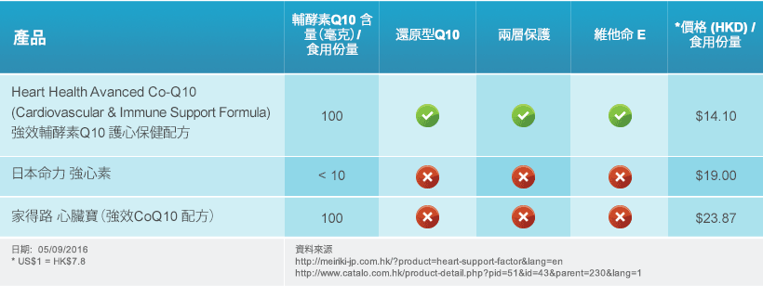
Competitors

Slide 36
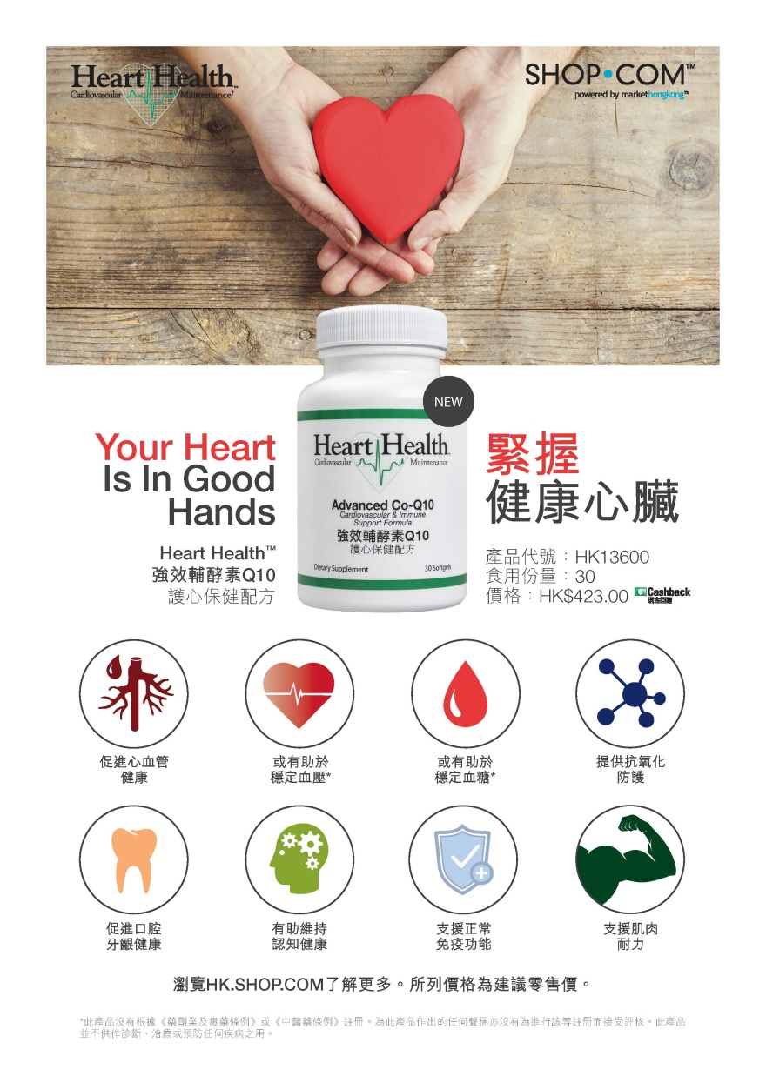
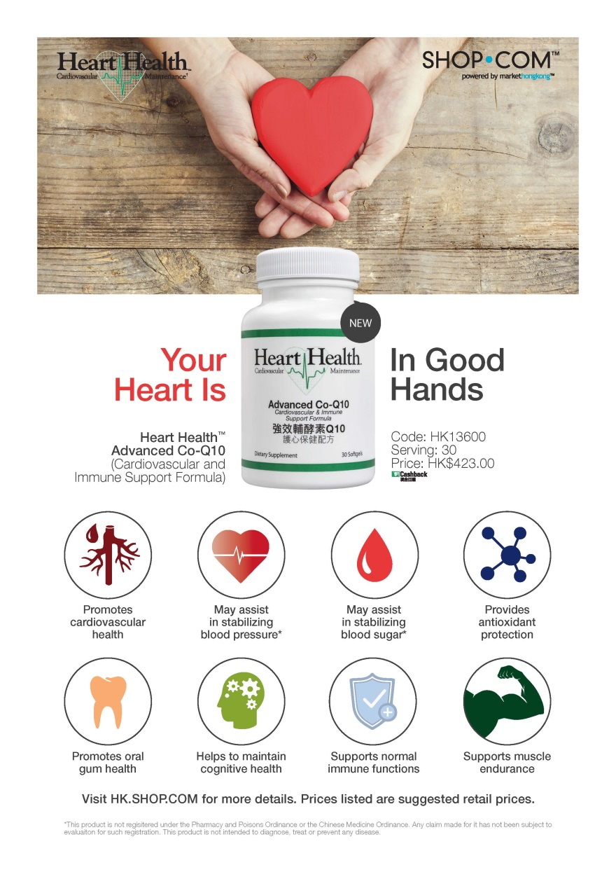

Slide 37
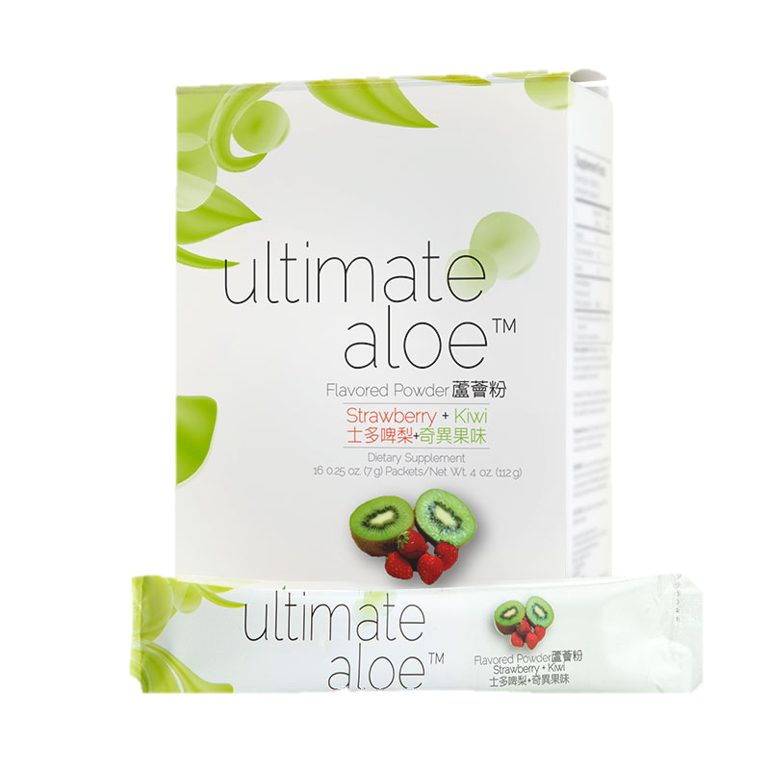
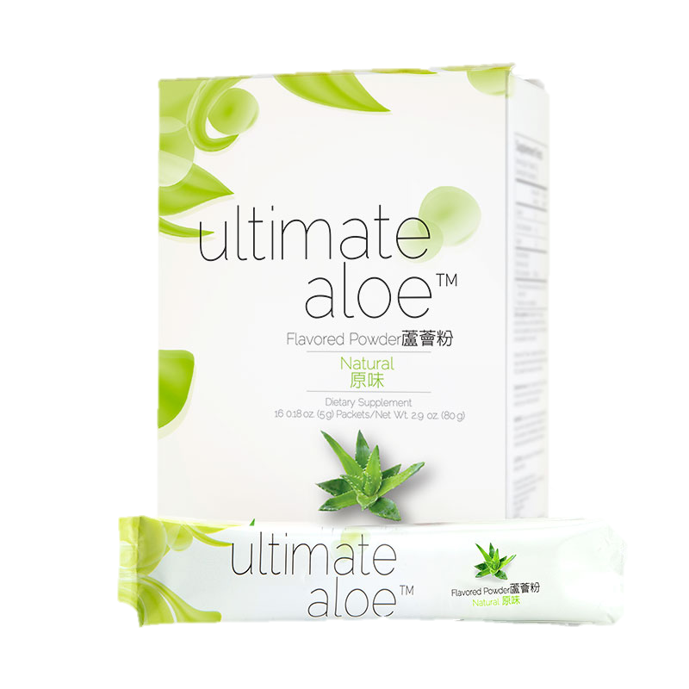
Ultimate Aloe Powder
蘆薈粉

Slide 38

Primary Benefits:
Supports digestive health
Helps to support immune health
May support digestive comfort
Meets or exceeds the International Aloe Science Council (IASC) standards for aloe purity and content.
Convenient powder packets – great for travel or sharing

Slide 39
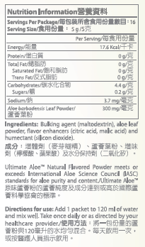
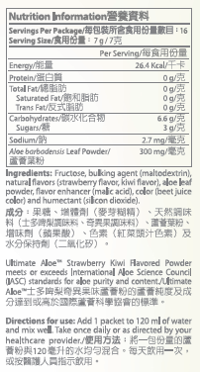
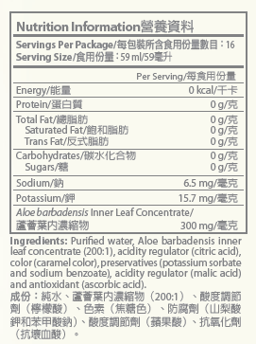
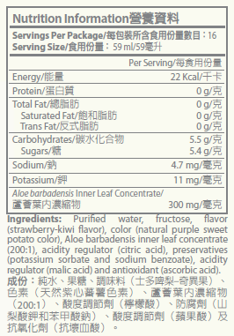
Ultimate Aloe™ Powder
Ultimate Aloe™

Slide 40
HK12810 – Natural
HK12860 – Strawberry Kiwi
UC HK$175.00
SR HK$245.00
BV 13.50
Servings: 16
Price per serving: HK$15.3

Slide 41
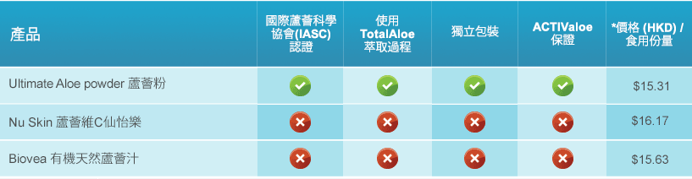
Competitors

Slide 42



Slide 43
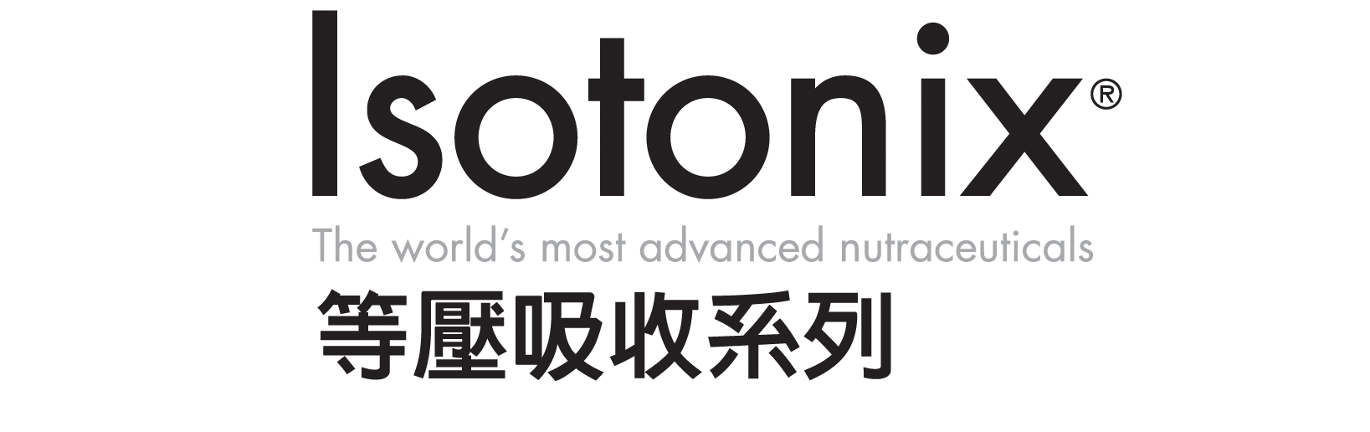
Isotonix® & New Products Breakout
November 15, 2016 (Tuesday)
2:00 - 4:00 p.m.

